Slide 1
Exception Handling

Slide 2
Types of Errors
In Java, there are two major types of errors:
Compile-time errors
Run-time errors (often referred to as exceptions)

Slide 3
Compile-time errors
Compile-time errors are those preventing the code from being compiled. Such errors can be either a syntax error or an error in the structure of the application.
Syntax errors are those that break a fundamental rule of Java syntax such as no semicolon at the end of a statement.
Other compile-time errors are related to the fundamental rules of workflow. For example, a variable named x is declared twice in the same scope.

Slide 4
Run-time errors
Run-time errors (often referred to as exceptions) are those only happen at run time and can’t be caught when the code is compiled
For eg, access to the element at index 5 of an array of length 4 throws a run-time error. The compiler says it looks good and compile the code; but when the application run, it is killed by an exception called ArrayIndexOutOfBoundsException

Slide 5
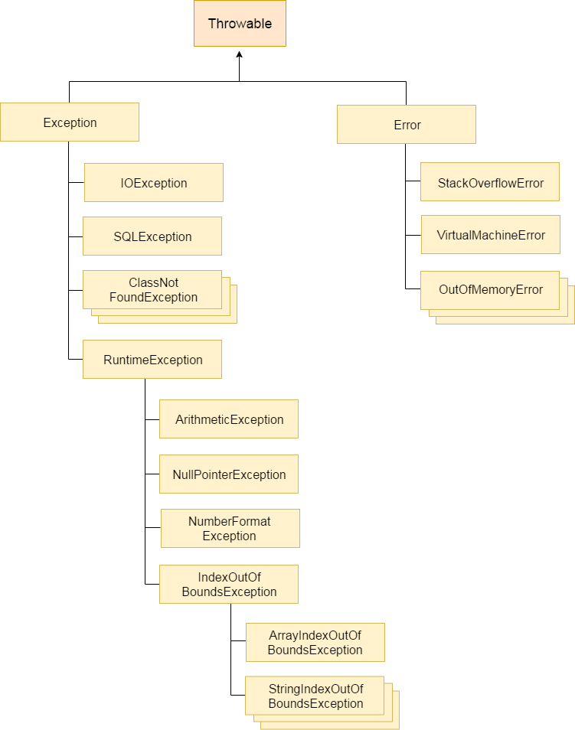
Hierarchy of Java Exception classes

Slide 6
Types of Java Exceptions
There are mainly two types of exceptions:
Checked
The classes which directly inherit Throwable class except RuntimeException and Error are known as checked exceptions e.g. IOException, SQLException etc. Checked exceptions are checked at compile-time.
Unchecked
The classes which inherit RuntimeException are known as unchecked exceptions e.g. ArithmeticException, NullPointerException, ArrayIndexOutOfBoundsException etc. Unchecked exceptions are not checked at compile-time, but they are checked at runtime.

Slide 7
Java Exception Handling Example
public class JavaExceptionExample{
public static void main(String args[]){
try{
//code that may raise exception
int data=100/0;
}catch(ArithmeticException e)
{System.out.println(e);
}
//rest code of the program
System.out.println("rest of the code...");
}
}

Slide 8
Java Exception Keywords
Keyword | Description
try | The "try" keyword is used to specify a block where we should place exception code. The try block must be followed by either catch or finally. It means, we can't use try block alone.
catch | The "catch" block is used to handle the exception. It must be preceded by try block which means we can't use catch block alone. It can be followed by finally block later.
finally | The "finally" block is used to execute the important code of the program. It is executed whether an exception is handled or not.
throw | The "throw" keyword is used to throw an exception.
throws | The "throws" keyword is used to declare exceptions. It doesn't throw an exception. It specifies that there may occur an exception in the method. It is always used with method signature.

Slide 9
Java catch multiple exceptions
Java Multi-catch block
A try block can be followed by one or more catch blocks. Each catch block must contain a different exception handler. So, if you have to perform different tasks at the occurrence of different exceptions, use java multi-catch block.
Points to remember
- At a time only one exception occurs and at a time only one catch block is executed.
- All catch blocks must be ordered from most specific to most general, i.e. catch for ArithmeticException must come before catch for Exception.

Slide 10
Example:
public class MultipleCatchBlock1 {
public static void main(String[] args) {
try{
int a[]=new int[5];
a[5]=30/0;
}
catch(ArithmeticException e) {
System.out.println("Arithmetic Exception occurs");
}
catch(ArrayIndexOutOfBoundsException e){
System.out.println("ArrayIndexOutOfBounds Exception occurs");
}
catch(Exception e) {
System.out.println("Parent Exception occurs");
}
System.out.println("rest of the code");
}
}

